Slide 1
Battle of the neighborhoods: Finding US cities similar to Phoenix
Author: Sasho Nedeljkovski
Capstone Project for Coursera

Slide 2
Business Problem
How do we identify similarities between different cities based on the available venues in each city?
What cities in the US are similar to Phoenix in terms of venues?

Slide 3
Data Sources
Foursquare:
Web API that allows users to create a free account
Return nearby venue data for a given latitude and longitude
Dynamic in nature
US Cities Data:
Obtained from opendatasoft.com
Contains names and coordinates of the 1000 most populous cities in the US
Downloadable as a CSV file
Static in nature

Slide 4
Methodology
Preprocessing
Data is parsed, required columns are extracted
Venue data is obtained from the API
Venue categories are one-hot encoded and normalized using mean
Clustering
K-means algorithm
One-hot encoded data is clustered
Similar cities tend to lie in the same cluster
Principal Component Analysis (PCA)
Reducing dimensionality of the data
In our case, data is represented using only 2 dimensions
Helps generate plot and visualize clusters

Slide 5
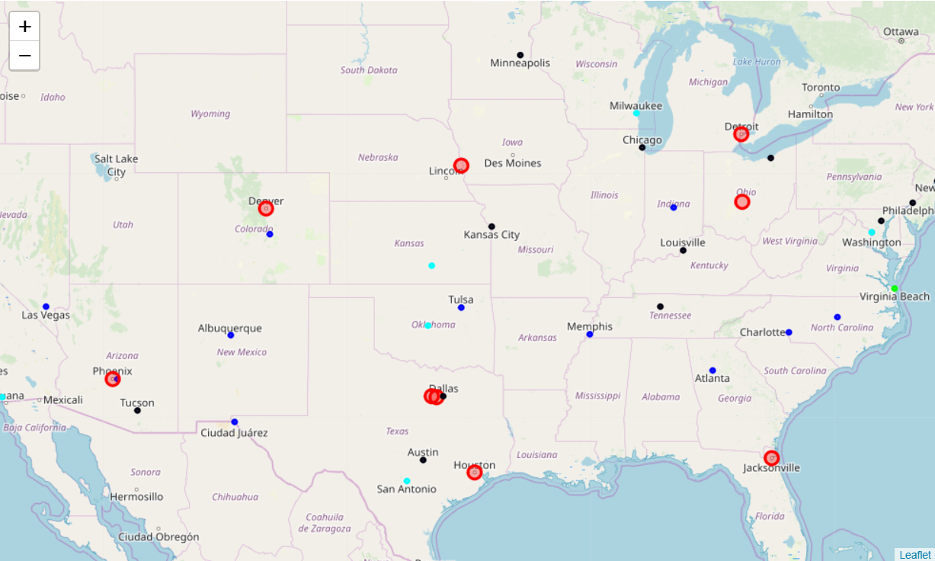
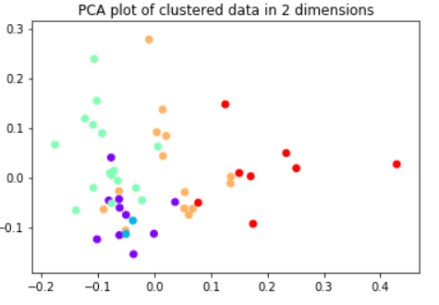
Results
Fig 1. Folium generated map of city clusters (Phoenix and similar cities are in red)
Fig 2. PCA plot with colors corresponding to cluster labels

Slide 6
Conclusion
Similar cities can easily be identified using location and venue data
PCA reveals the extent of similarity
Interesting patterns can be discovered by analyzing more cities
Results depend on the amount of venues processed

